Slide 1

AUTOMATED VISUAL TESTING

Slide 2
AGENDA
Why automated visual testing?
Tools & Technology
Where does it fit?

Slide 3
WHAT IS VISUAL TESTING?
A quality assurance activity aimed to verify that a Graphical User Interface appears correctly to users

Slide 4

A VISUAL BUG

Slide 5

WHY SHOULD IT BE AUTOMATED?
THE TEST MATRIX IS TOO BIG TO APPROXIMATE MANUALLY
Web browsers
Operating systems
Screen resolutions
Responsive designs

Slide 6
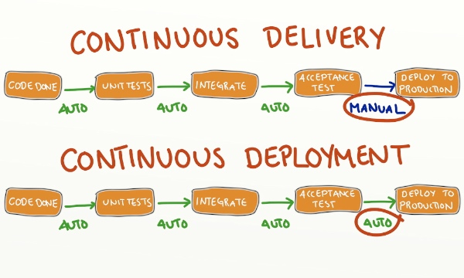
WHY SHOULD IT BE AUTOMATED?

Slide 7
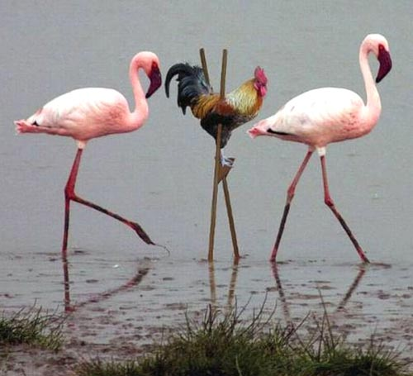
WHY SHOULD IT BE AUTOMATED?
MANUAL VISUAL TESTING IS ERROR PRONE

Slide 8










WHY SHOULD IT BE AUTOMATED?
Many are already doing it (and sharing)…
Grunt PhotoBox
dpdxt
Needle
FBSnapshotTestCase
Specter
PhantomCSS
Fighting Layout Bugs
Wraith
Eyes
CSSCritique
Huxley
VisualCeption
Snap And Compare
Selenium Visual Diff
Gemini
WebdriverCSS
Notes:
Most tools are for web apps except for FBSnapshotTestCase which is for IOS and Eyes which is platform agnostic.

Slide 9
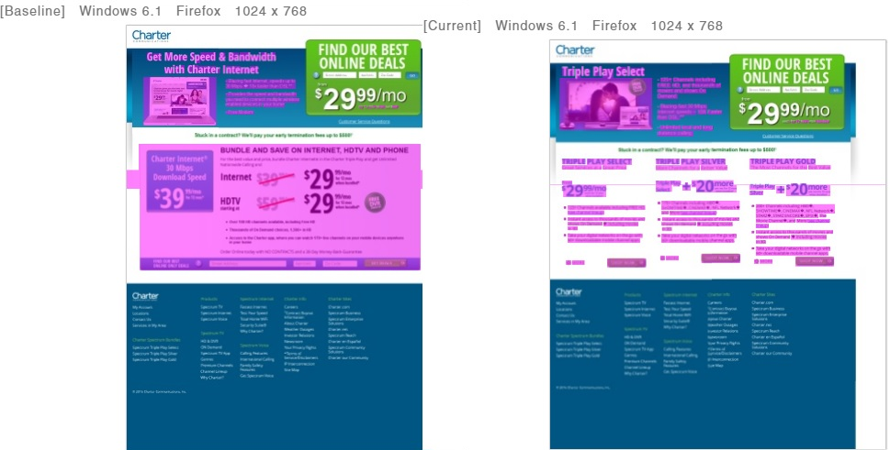
Need to compare the UI of different environments (eg. Prod and QA)

Slide 10
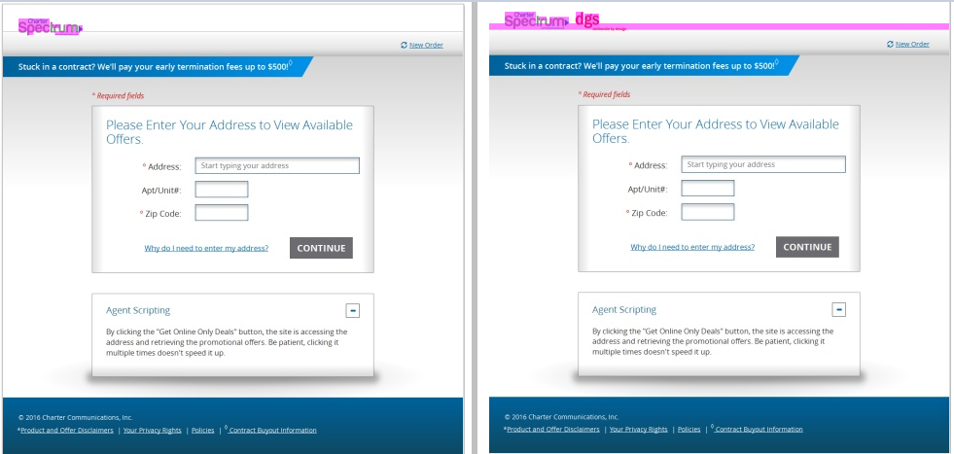
Need to compare the different urls

Slide 11
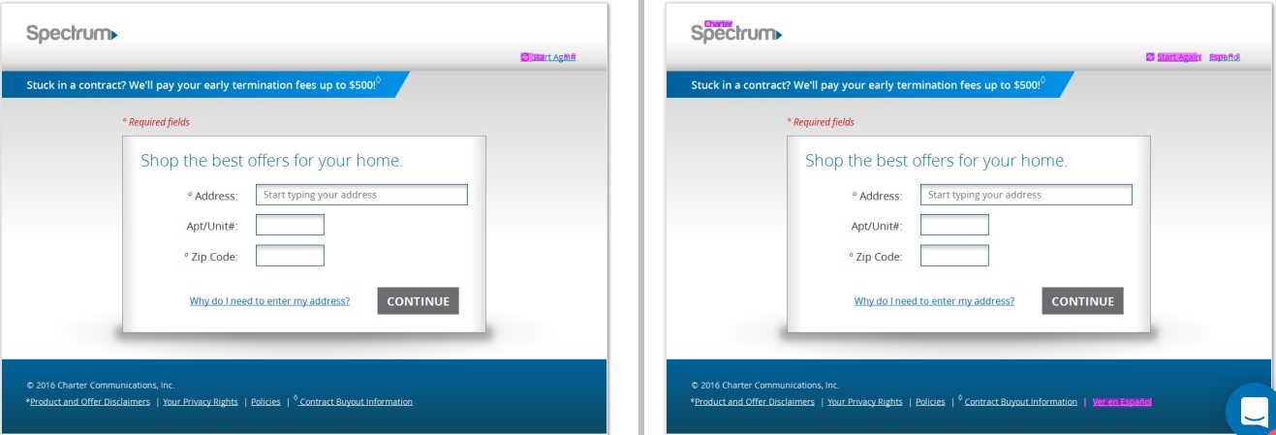
Need to compare the UI against a given mock up

Slide 12
AGENDA
Why automated visual testing?
Tools & Technology
Where does it fit?

Slide 13
THE WORKFLOW
Drive the AUT and take screenshots
Report differences
Compare screenshots with baseline images
Update the baseline
Notes:
* Does not apply to fighting layout bugs.

Slide 14
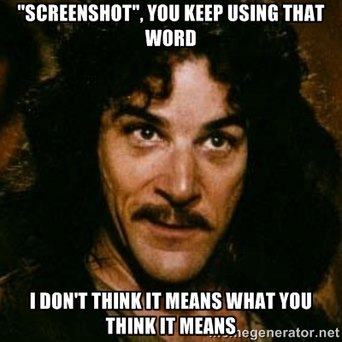
SCREENSHOTS
Real browsers?
Full page?
Frames?
Regions?
Viewport size?
Page stabilization?
Page preparation?

Slide 15
THE WORKFLOW
Drive the AUT and take screenshots
Report differences
Compare screenshots with baseline images
Update the baseline
Notes:
* Does not apply to fighting layout bugs.

Slide 16
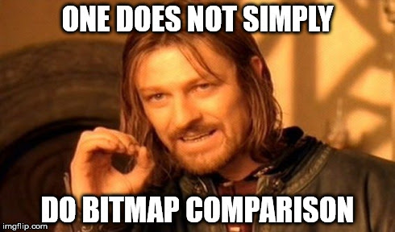
Notes:
Like Boromir said…

Slide 17
WHY NOT?
FALSE POSITIVES

Slide 18
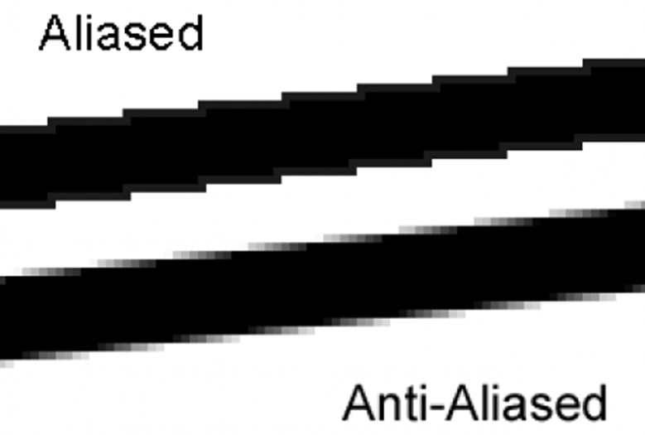
ANTI-ALIASING?

Slide 19


ANTI ALIASING 1/2

Slide 20

ANTI ALIASING 2/2

Slide 21


BRIGHTNESS 1/2

Slide 22


BRIGHTNESS 2/2

Slide 23


SUB PIXEL SHIFTS 1/2

Slide 24


SUB PIXEL SHIFTS 2/2

Slide 25

SUB PIXEL SHIFTS 1/2

Slide 26

SUB PIXEL SHIFTS 2/2

Slide 27

AND MORE…
1 pixel offsets in element positioning
Dynamic content
Moving elements
Images of different size

Slide 28


Slide 29
Image Comparison APIs

Slide 30
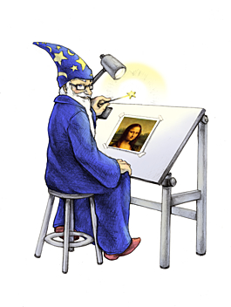
ImageMagick
A powerful command line tool for image processing.
APIs are available for most programming languages.
Fuzzing is used to eliminate slight color differences
An error ratio is usually used to determine a match
$ compare –metric AE –fuzz 5% img1.png img2.png diff.png
2246

Slide 31
Resemble.js
An image comparison tool implemented in JavaScript
Used by Phantom CSS and other tools.
Good de-antialiasing
An error ratio is usually used to determine a match
http://huddle.github.io/Resemble.js/

Slide 32

Applitools Eyes
A specialized image processing stack designed to compare computer generated UI images
Anti-aliasing
Partial and full pixel offsets
Images of different size
Dynamic content
Moving elements
Layout matching
Available as a cloud service

Slide 33
THE WORKFLOW
Drive the AUT and take screenshots
Report differences
Compare screenshots with baseline images
Update the baseline
Notes:
* Does not apply to fighting layout bugs.

Slide 34
REPORT DIFFERENCES

Slide 35
THE WORKFLOW
Drive the AUT and take screenshots
Report differences
Compare screenshots with baseline images
Update the baseline
Notes:
* Does not apply to fighting layout bugs.

Slide 36
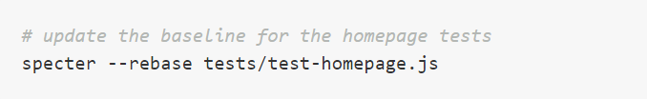
UPDATE THE BASELINE
Rename or commit individual image files
Overwrite mode

Slide 37
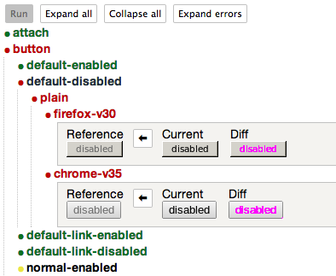
UPDATE THE BASELINE
GUI (Gemini GUI)
Automatic maintenance

Slide 38
AGENDA
Why automated visual testing?
Tools & Technology
Where does it fit?

Slide 39
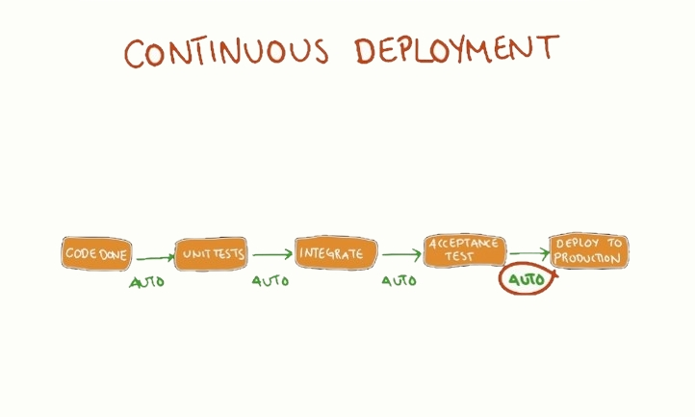
WHERE DOES IT FIT?
Components
Code review
Developers
Designers
QA
Notes:
CSS files and HTML falling out of sync
CSS changes with unexpected global implications.
Frontend refactoring.

Slide 40
WHERE DOES IT FIT?
Pages
Page sections
Developers
Designers
QA
Others
Notes:
Project / Product managers (collaboration)

Slide 41
WHERE DOES IT FIT?
Staging vs. Production
Ops
QA

Slide 42
WHERE DOES IT FIT?
Monitoring
Ops
QA
Notes:
Data from external sources
Not enough time to test pre-production
Missing components in deployment.

Slide 43
QUESTIONS?

Slide 44
THANK YOU

